Slide 1
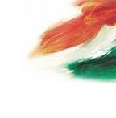
INDIA A DISCOVERY

Slide 2
Welcome to Delhi
Delhi is a city where time travel is feasible. Step aboard your time machine (the sleek and efficient metro) and you can go from Old Delhi, where labourers haul sacks of spices and jewellers weigh gold on dusty scales, to modern New Delhi, with its colonial-era parliament buildings and penchant for high tea. Then on to the future: Gurgaon, a satellite city of skyscraping offices and glitzy malls.

Slide 3
This pulsating metropolis has a bigger population than Australia, and is one of the world's most polluted cities. But woven into its rich fabric are moments of pure beauty: an elderly man threading temple marigolds; Sufi devotional songs; a boy flying a kite from a rooftop.
Delhi is a city that has been repeatedly ravaged and reborn, with vestiges of lost empires in almost every neighbourhood. There's so much to experience here, it's like a country in itself.

Slide 4
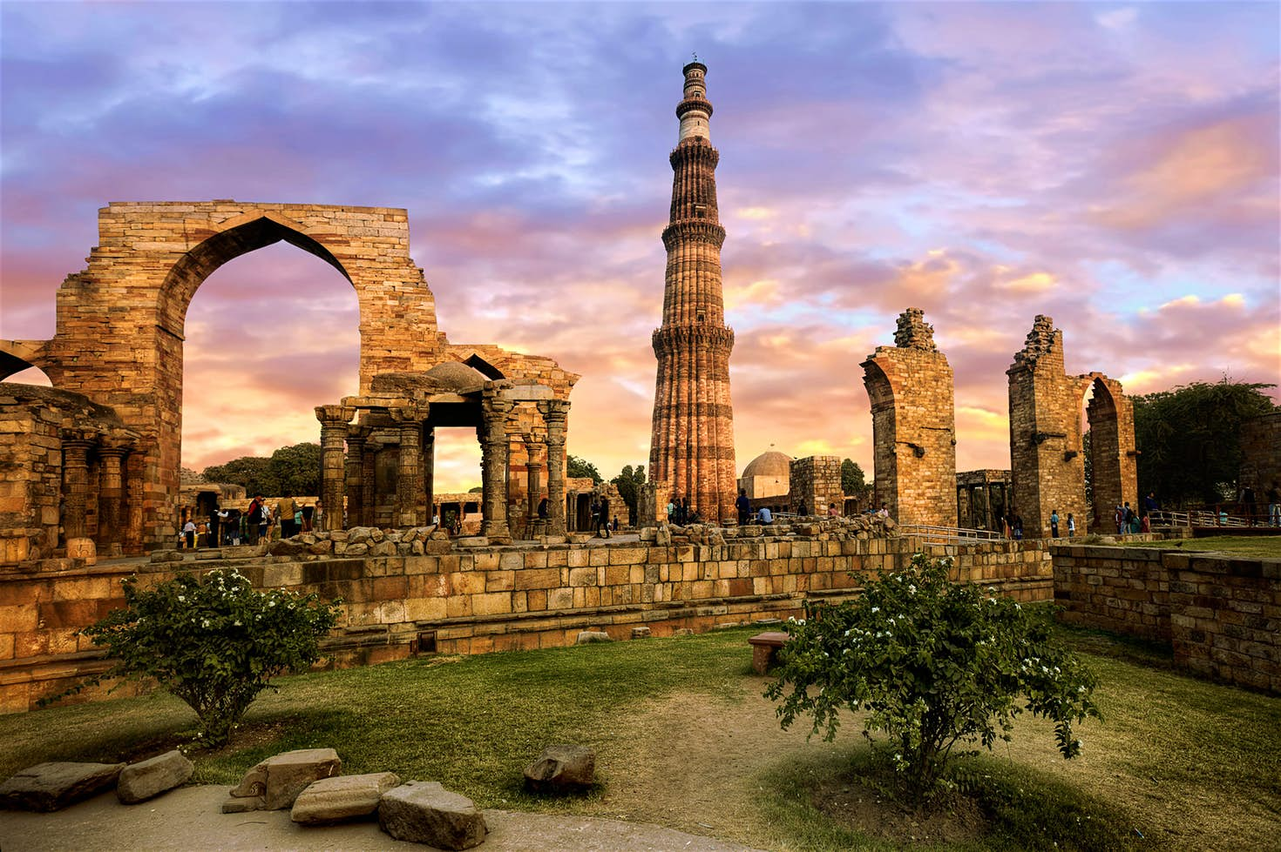
What to expect in Delhi?
History

Slide 5
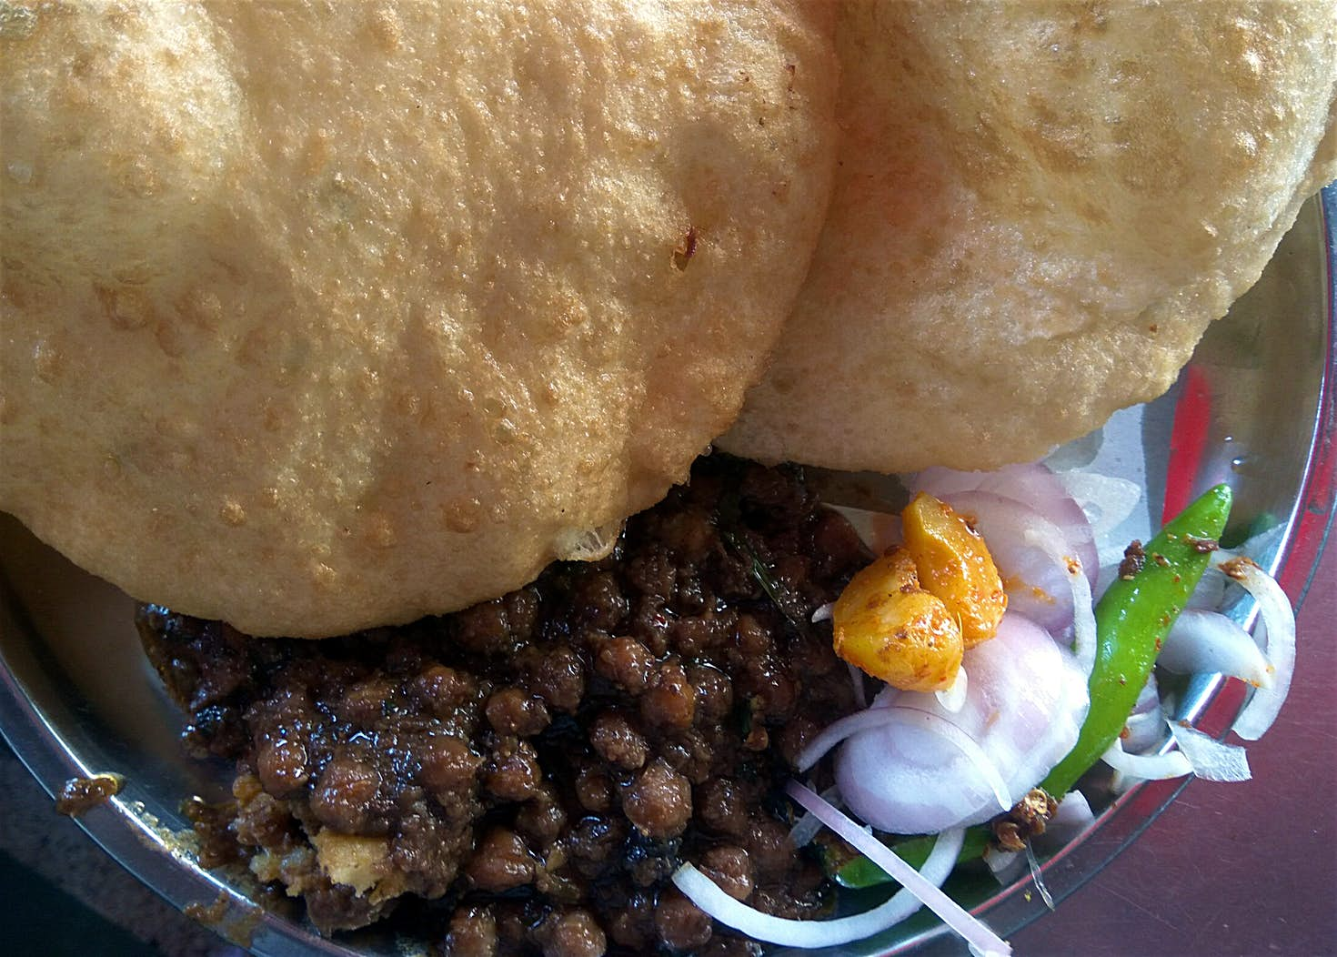
food

Slide 6
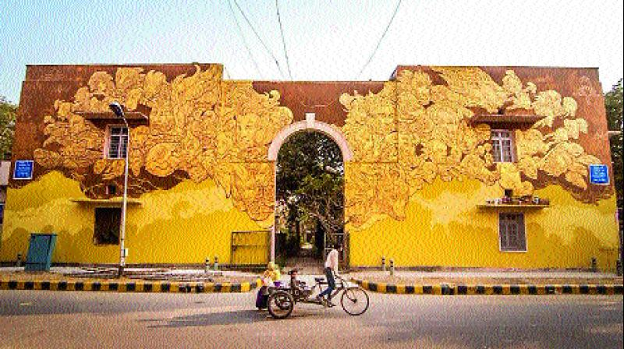
Art

Slide 8
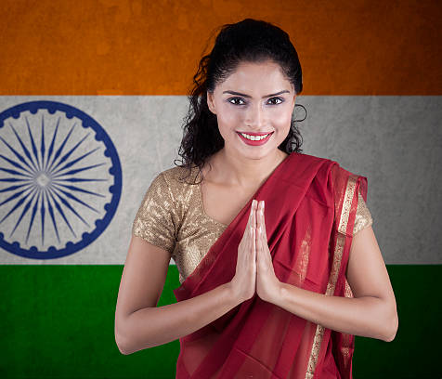
THANK YOU

